Slide 1
Shiny App: Explore Prison Survey
Project Team 25
Biniam Garomsa
Kelly Culpepper

Slide 2
Motivation
The effects of prison on mental health
Medical Problems Reported by Prisoners
Study important social justice issues such as racial disparities in sentencing
Our Focus: The effect of drug and alcohol on prisoners

Slide 3
Objective
Create a shiny app to allow users easily interact and visualize the data
Explore demographics and crime types of prison population
Explore the relation of alcohol and drugs on incarceration in the US

Slide 4
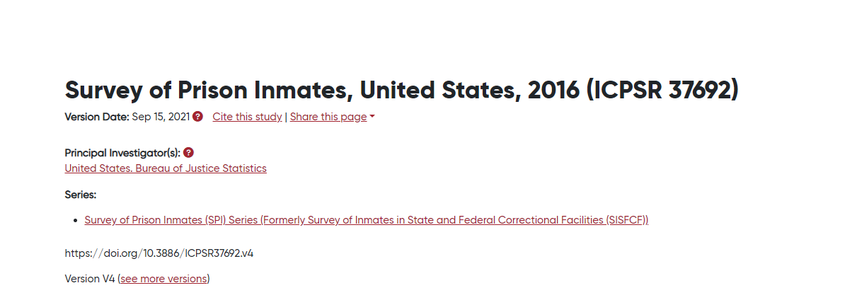
Data
No. of Cases: 24,848
No. of Variables: 2,104
364 prisons (306 state and 58 federal)

Slide 5
Data cleaning and filtering
Selected Columns
Alcohol
Marijuana
Cocaine
Heroin
Highest_Year_Education_Before_Prison
Race, Age, Sex, State
Crime_type
Time of use, Drug Type, Number of drugs

Slide 6
Demo
sta323-sp23/project-team25 (github.com)

Slide 7
References
Data source: Survey of Prison Inmates, United States, 2016 (umich.edu)

